Slide 1
Automating boring stuff with Python
(like homework)
Matthew Mirvish

Slide 2
Who am I?
Definitely not a professional, that’s what.
Notes:
Well sometimes I do robots (used to be a rover, now it’s a submarine), sometimes I _start_ making games (key word: start) and a lot of the time those things are made in python.

Slide 3
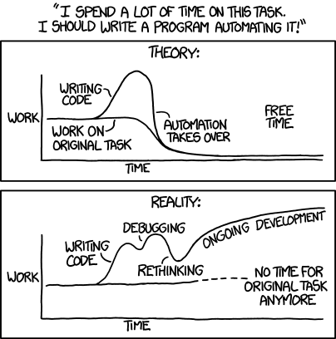
Automation
Homework
Calendar events
Programming
Making other automation tools
Notes:
However, a surprisingly large amount of the time I’m writing automation tools. (most of the work in programming is work towards making the work itself easier).
(homework automation)
(fixing calendar issues)
(making programming easier)
(joke about writing automation tools to automate making other automation tools)

Slide 4
Why python?
Simpler to write
Huge amounts of libraries
“Scripting” functionality
Notes:
Scripting functionality: you can just open up notepad and write some code

Slide 5
Examples

Slide 6
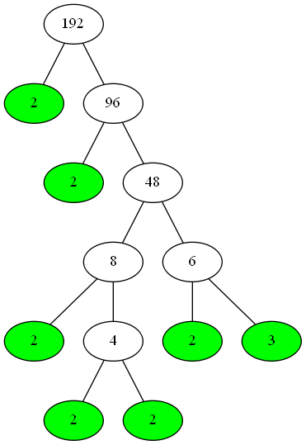
“Factor Trees”
Exercise in finding prime factors
Huge pain
Automated with PYTHON
Notes:
You essentially drew up a tree like this: <click>

Slide 7
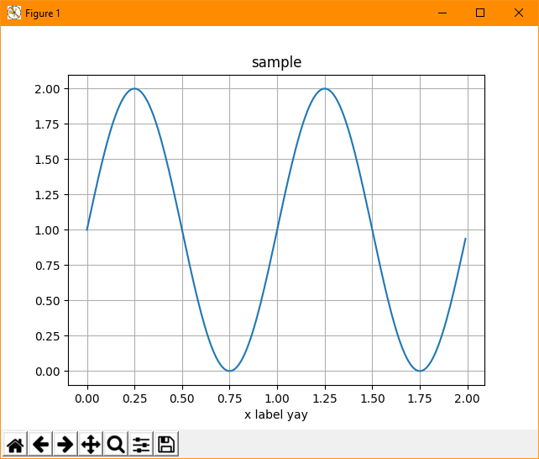
Making diagrams with python
PyDot (flowchart diagrams)
matplotlib (graphs graphs and more graphs)
Notes:
<cut to some smaller examples>

Slide 8
Excel Processing
ETABS Files

Slide 9
ETABS output processing
Reading excel files, doing math™ on them, making other excel files.
Supports the ETABS API!
Notes:
Explain etabs thingy, show how it supports the ETABS api, if you want to tire yourself with its documentation

Slide 10
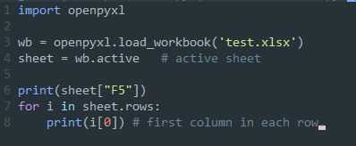
openpyxl
Library which handles excel files:
Notes:
Explain more features of openpyxl

Slide 11
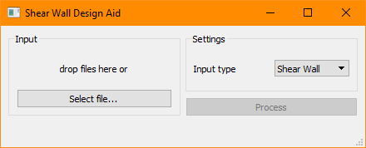
GUI with Qt
PySide – is free and has good documentation, but missing a few lesser used features
PyQt5 – not free for commercial use, poorer documentation
Notes:
Explain Qt, differences between bindings

Slide 12
Result
(work in progress)
Notes:
Show results with gui

Slide 13
Calendar Automation
Because my school just couldn’t use a system that makes sense.

Slide 14
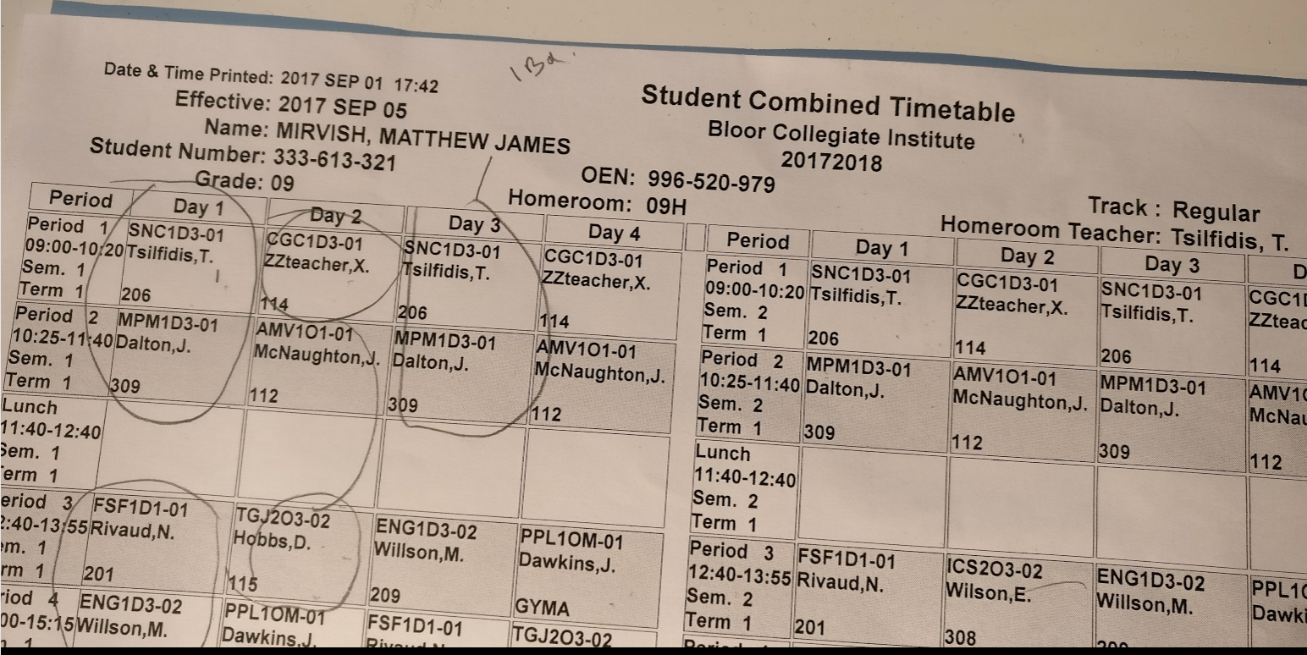
The problem
School calendar system operates on a 4-day cycle.
Google calendar does not support this, especially considering late start days.

Slide 15
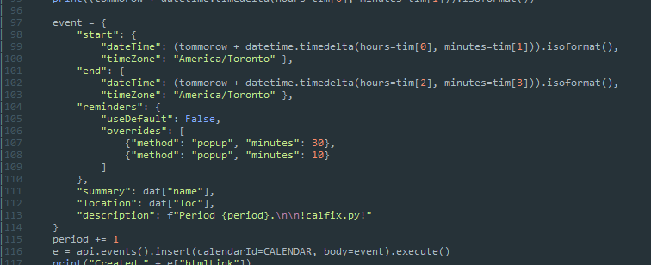
Generating calendar events with python
Google calendar has an API module for python:

Slide 16

Date facilities
Working with the calendar, date/time libraries are required.
Python’s standard library has a datetime module.

Slide 17
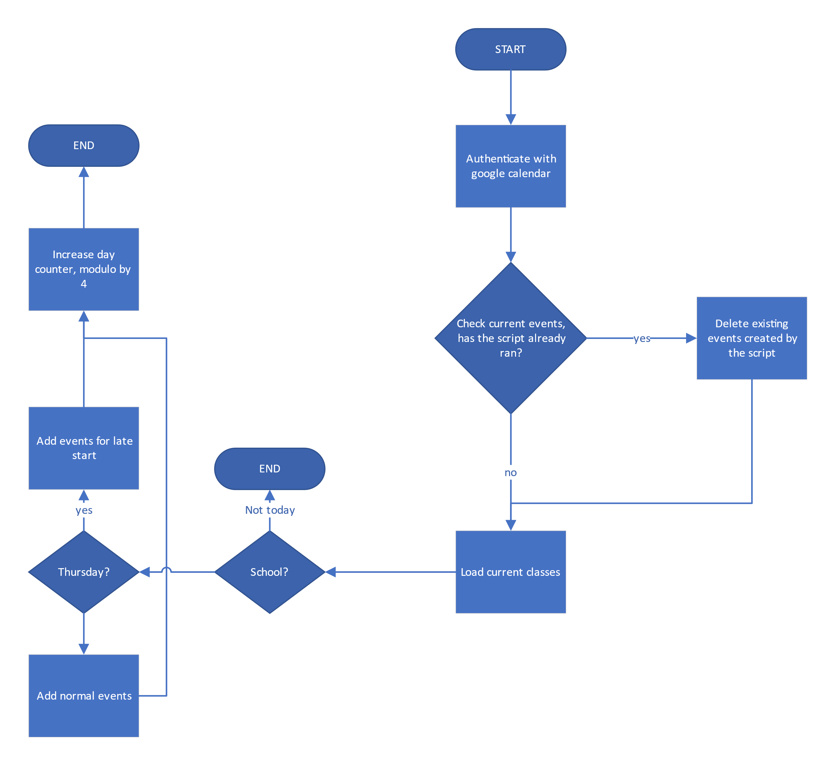
Result
Even with the complicated logic & calendar API, the code is only about 100 lines.

Slide 18
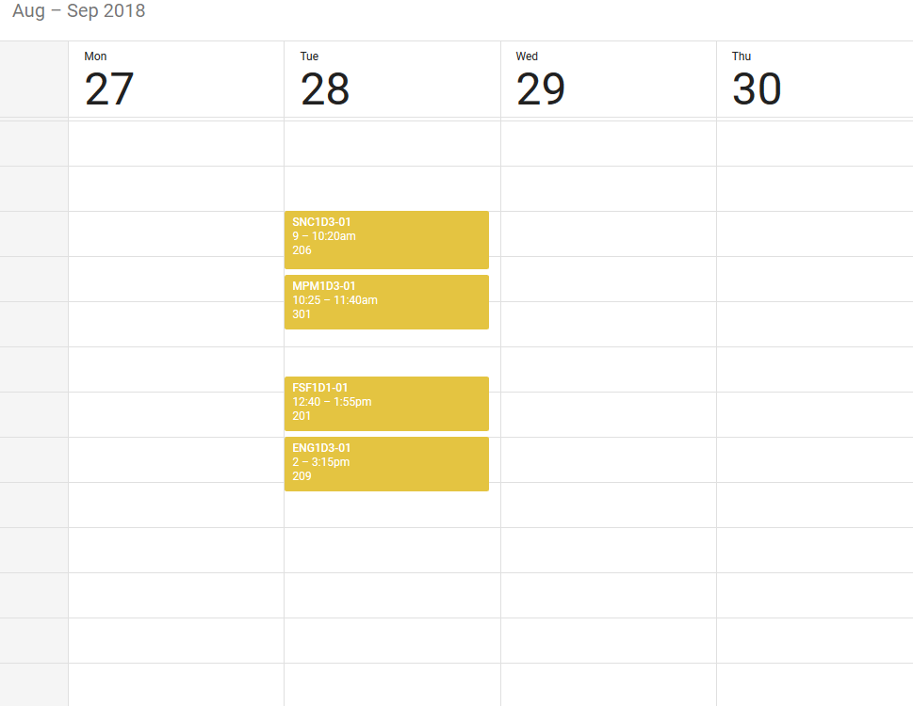
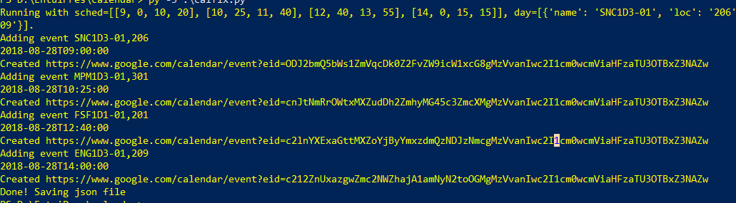
Result

Slide 19
Smaller scale examples
Sometimes you don’t need to tie in twenty different things, after all.

Slide 20
Fixing other programs’ output
Tool which is supposed to automate generating a Makefile.
Fails and needs manual intervention

Slide 21
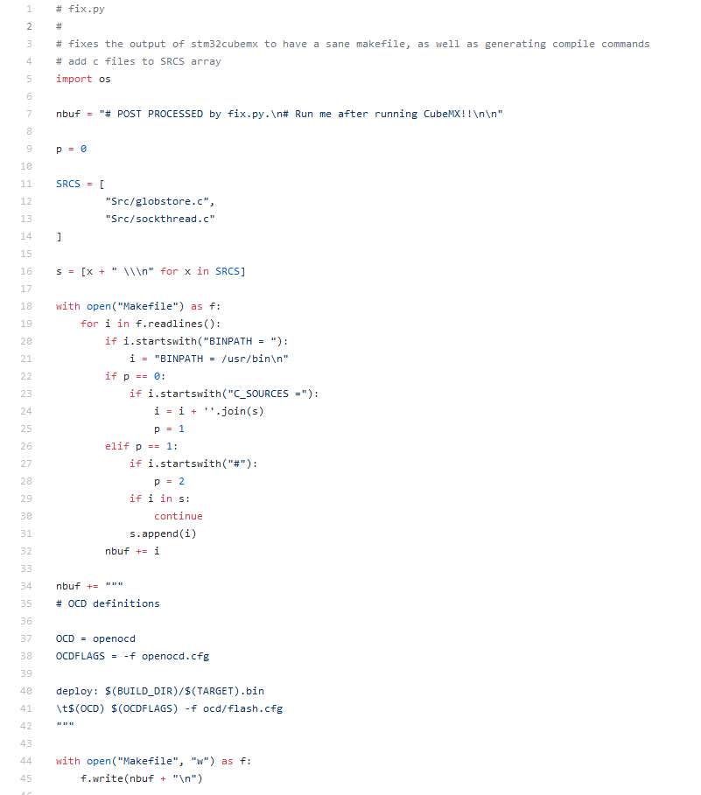
Fixing other programs’ output
Wrote a small program to fix it for me.

Slide 22
adds header
reads file
replaces invalid line
removes duplicates
adds extra instructions
writes to file

Slide 23
Calculating inertial matricies
Doing robot sim requires accurate information about robot’s dynamics
Calculating the inertial matrix is a huge pain
Automated with PYTHON

Slide 24
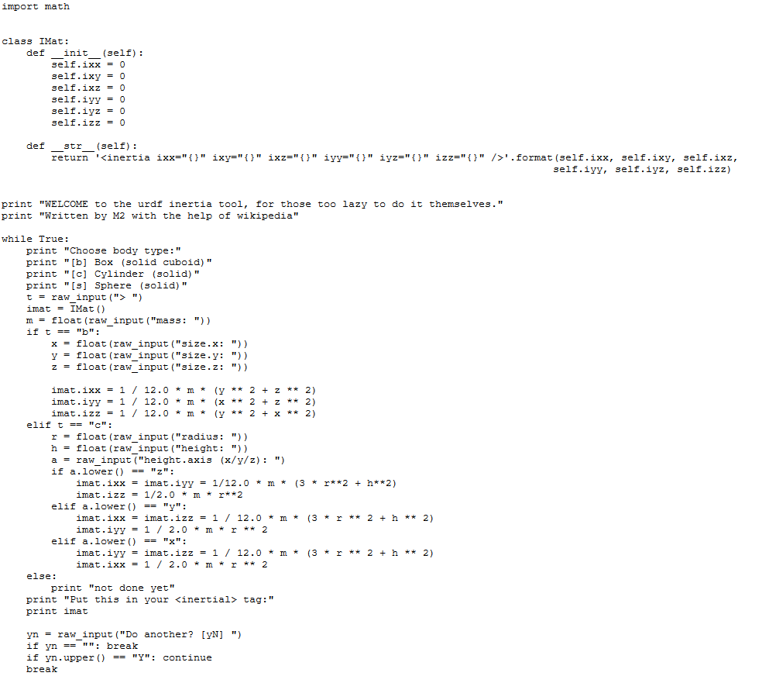
helper to generate inertial tag for robot description file
interface for inputting values
inertia calculators

Slide 25
Jupyter Notebooks
No longer IPython. RIP IPython notebooks :)

Slide 26
Jupyter notebooks
Came from scientific community
Mixes runnable code with text & interactives.
Web interface, MS provides hosted private notebooks servers
https://notebooks.azure.com/mincrmatt1/libraries/snc1d3mm12

Slide 27
Uses
Prototyping
Math-heavy scripting
Slideshows/presenting code
Doing your homework!

Slide 28
Other things I’ve done with python
Usually related to school.

Slide 29
Automating art
Instead of being creative and making art to represent “elements of art”, I made programs to make the art.
Surprisingly I actually got a good grade for this stunt.

Slide 30
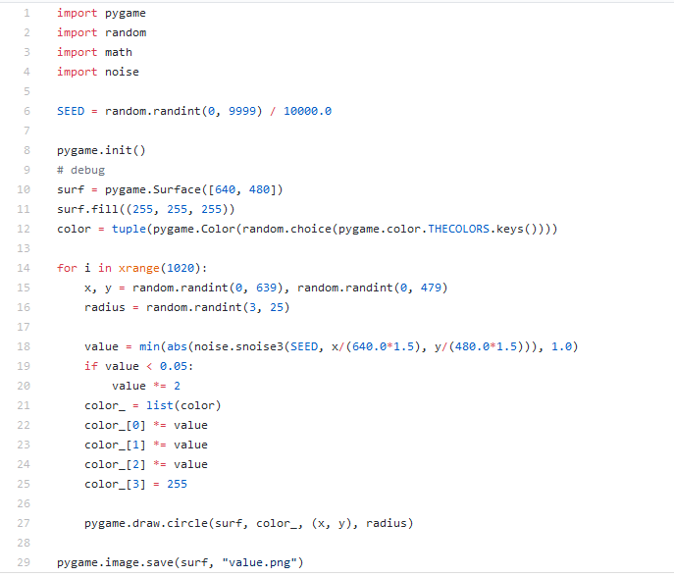

Automating art

Slide 31
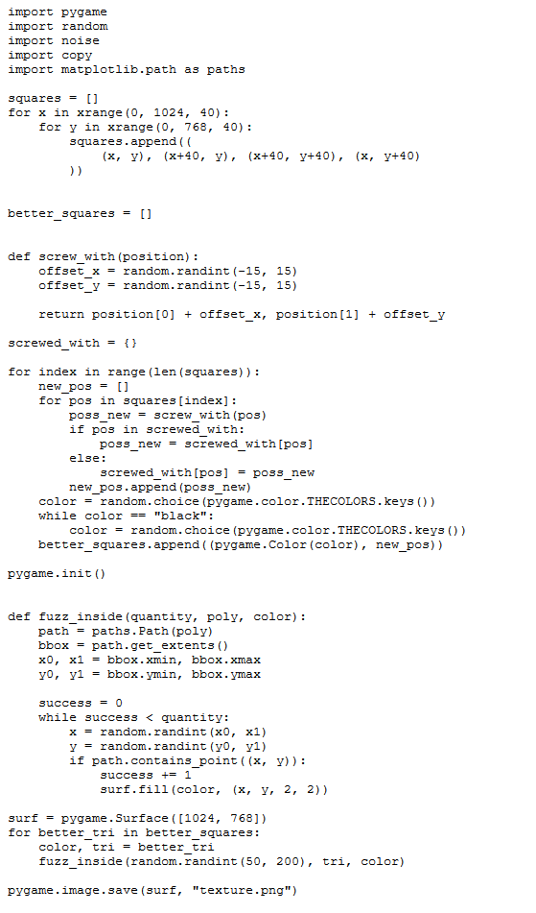
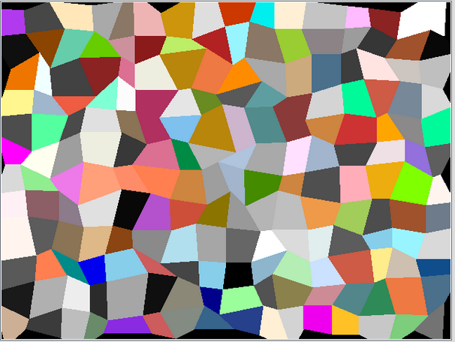
Automating art

Slide 32
3D Engine?
Once we had to make a 3D model of a backyard for school.
We were supposed to use a game or something similar.
I wrote a 3D engine.

Slide 33
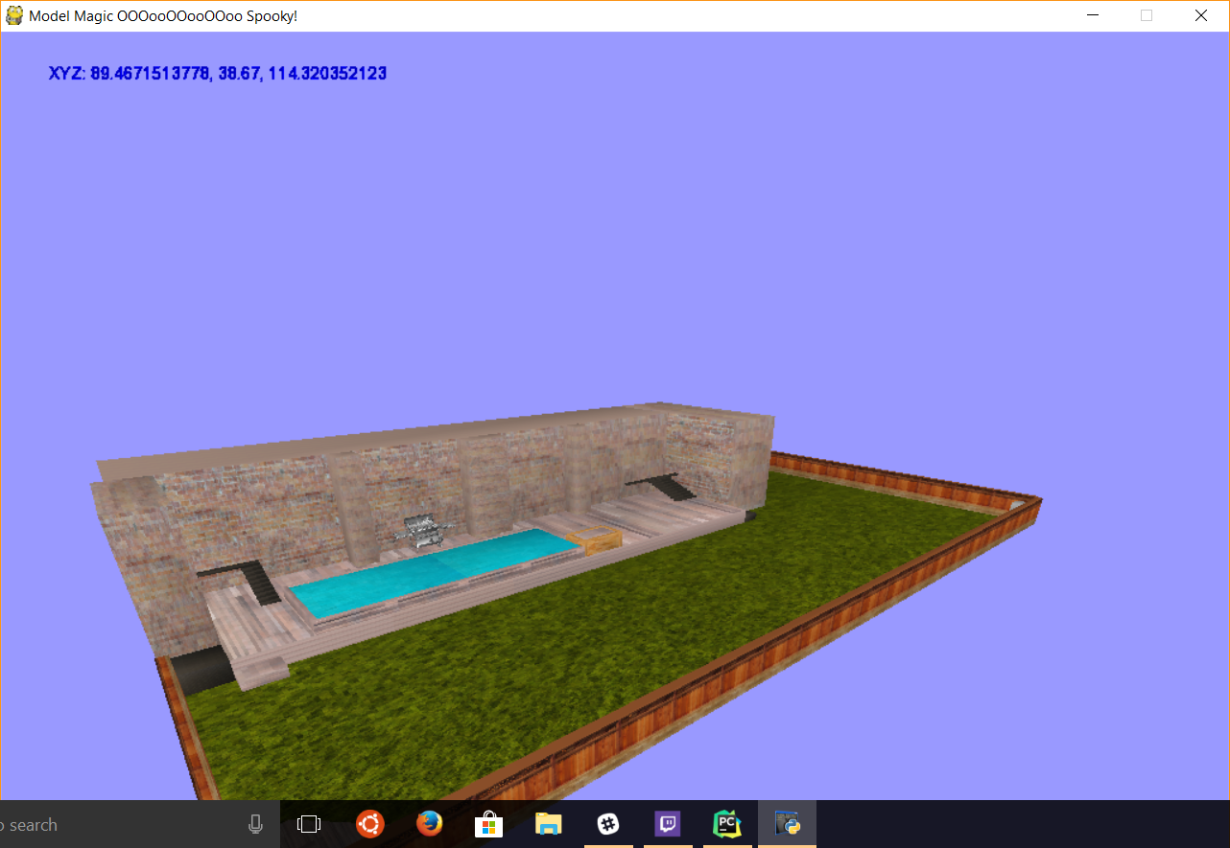
3D Engine

Slide 34
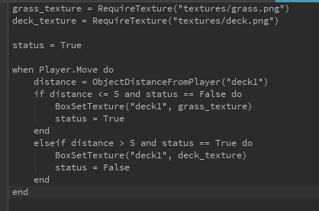
3D Engine
After realizing I’d need scripting support, I then wrote another language inside of python.

Slide 35
3D Engine
I then proceeded to get a 4- on it. I am still angry to this day.

Slide 36
End
Questions?

